Slide 1
How ? FL Design
Vimalkumar Kumaresan Ph.D

Slide 3
Components
Major Components of FL:
(Cluster) Aggregator
(Distributed) Agent
Database Server
Communication

Slide 4
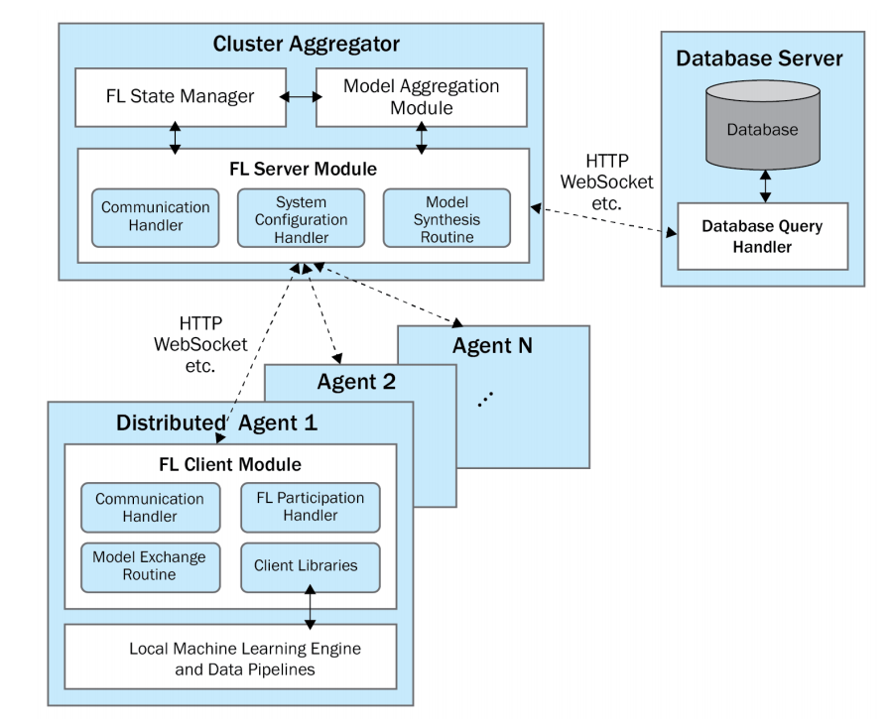
System Architecture

Slide 5
(Cluster) Aggregators
Server Module
Communication Handler
Registration
Authentication
Model Initialization
Participants
Agent Models
DB communication
System Configuration Handler
Registration
Tracking
Model Synthesis routine
Collection

Slide 6
Agents
Client
Communication Handler
Participation Handler
Model Exchange Routine

Slide 7
Database Server
Database Query Handler
Database
Aggregator Information
Agent Information
Base Model Information
Local and Global Model Info
Performance Data

Slide 8
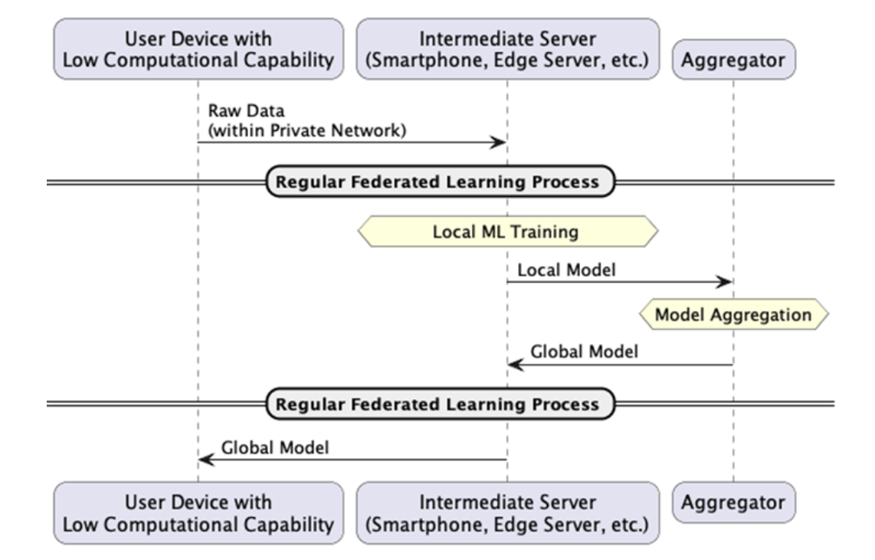
Intermediate Server

Slide 9
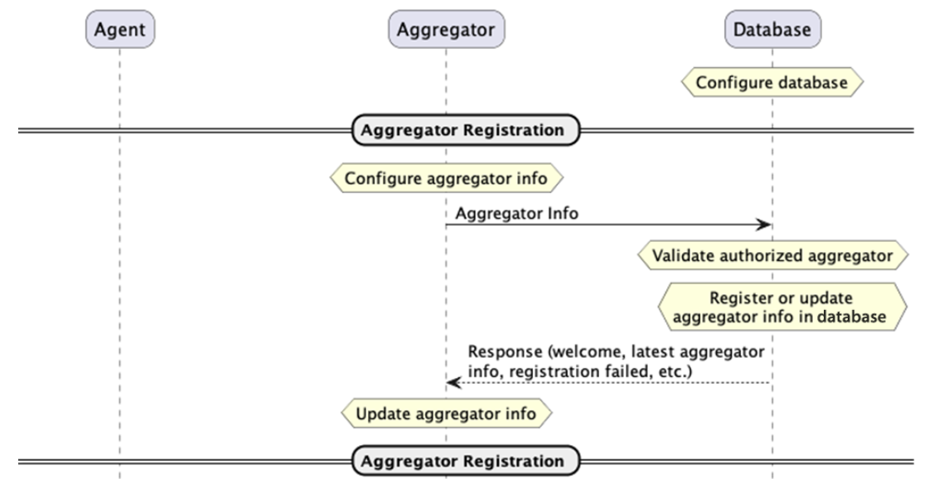
System Flow (SF): Initialization (Aggregator)

Slide 10
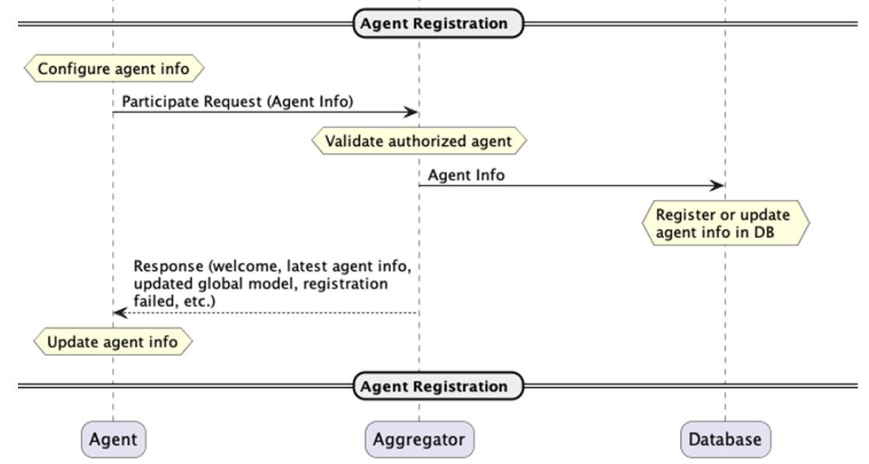
System Flow (SF): Initialization (Agent)

Slide 11
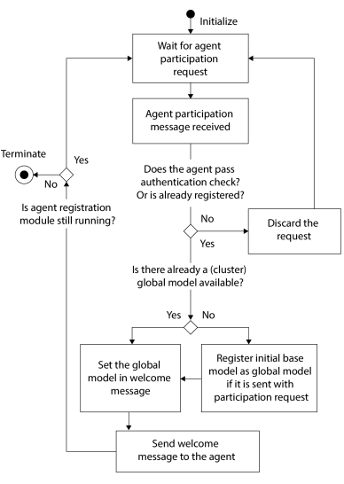
Registration

Slide 12
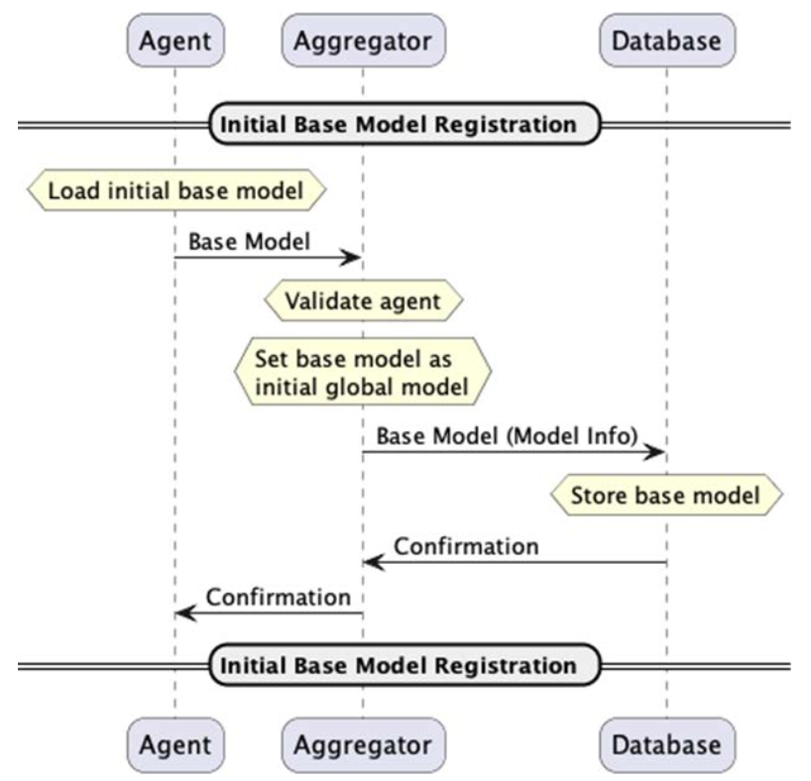
Base Model Upload

Slide 13
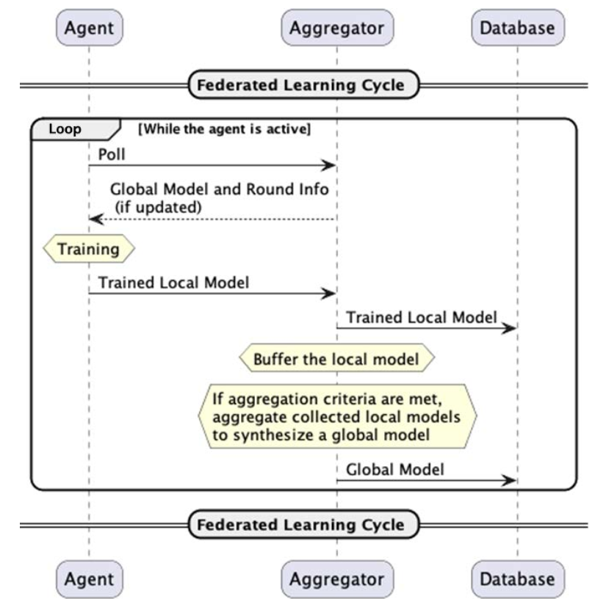
Continuous Learning Cycle

Slide 14
Communication
Synchronous FL
Asynchronous FL

Slide 15
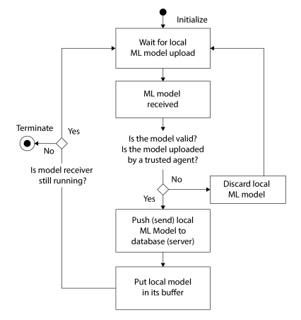
Aggregator-side FL
cycle and process
Accepting and Caching Local ML Models

Slide 16
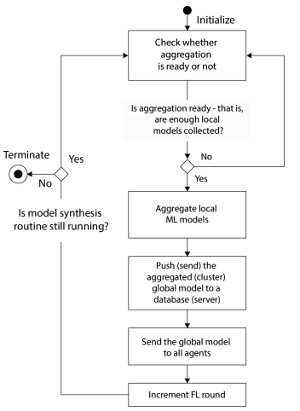
Aggregating Local ML Models
Model synthesis routine: aggregating local ML model

Slide 17
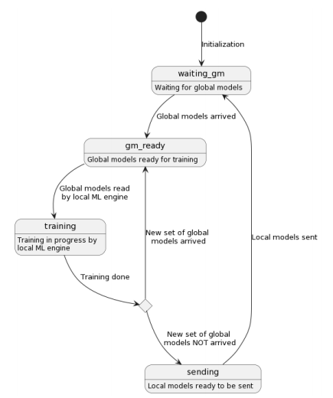
Agent-side local retraining cycle
Agent-side state transition to adapt and update the ML model.

Slide 18
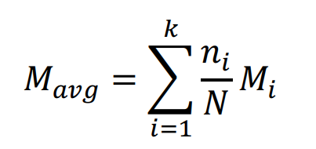
Model Aggregation
FedAvg - Federated Averaging

Slide 19
FedMA: Federated Matching Average
FedMA constructs the shared global model in a layer-wise manner by matching and averaging hidden elements (i.e. channels for convolution layers; hidden states for LSTM; neurons for fully connected layers) with similar feature extraction signatures.

Slide 20
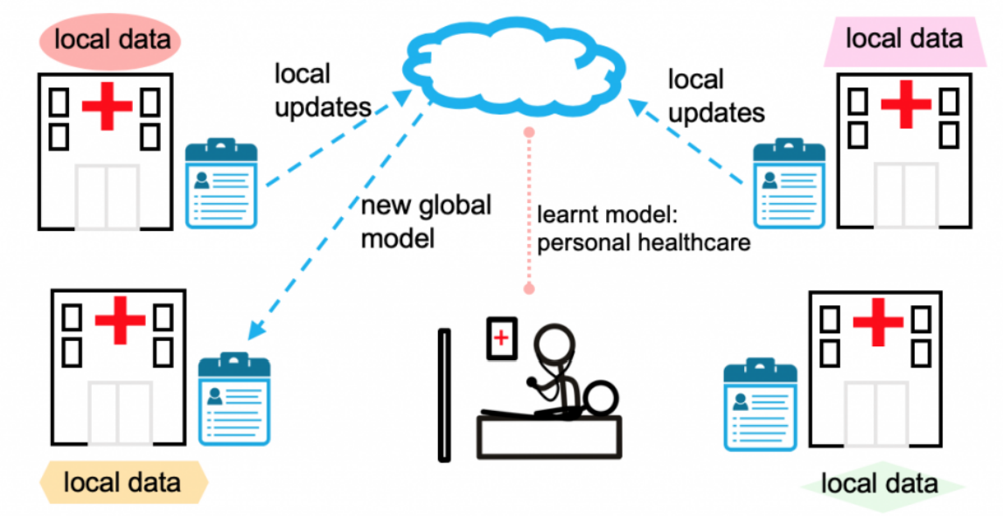

Slide 21
FL Frameworks
FedLab
Flower
FATE
FedScale
Other DL/ML Frameworks

